Slide 1
Data Processing
Tong He
Applied Scientist, Amazon Web Services.
2018.12.18

Slide 2
Data Collection

Slide 3
Data Collection
Format
Label
Directory Structure

Slide 4
Data Collection
Format: Task Specific
Classification: the label
Detection: the boxes, and labels
Segmentation: the masks, and labels

Slide 5
Data Collection
Labeling
Manual
Accurate, Expensive
Automatic
Somewhat accurate, cheap
SageMaker Ground Truth

Slide 6
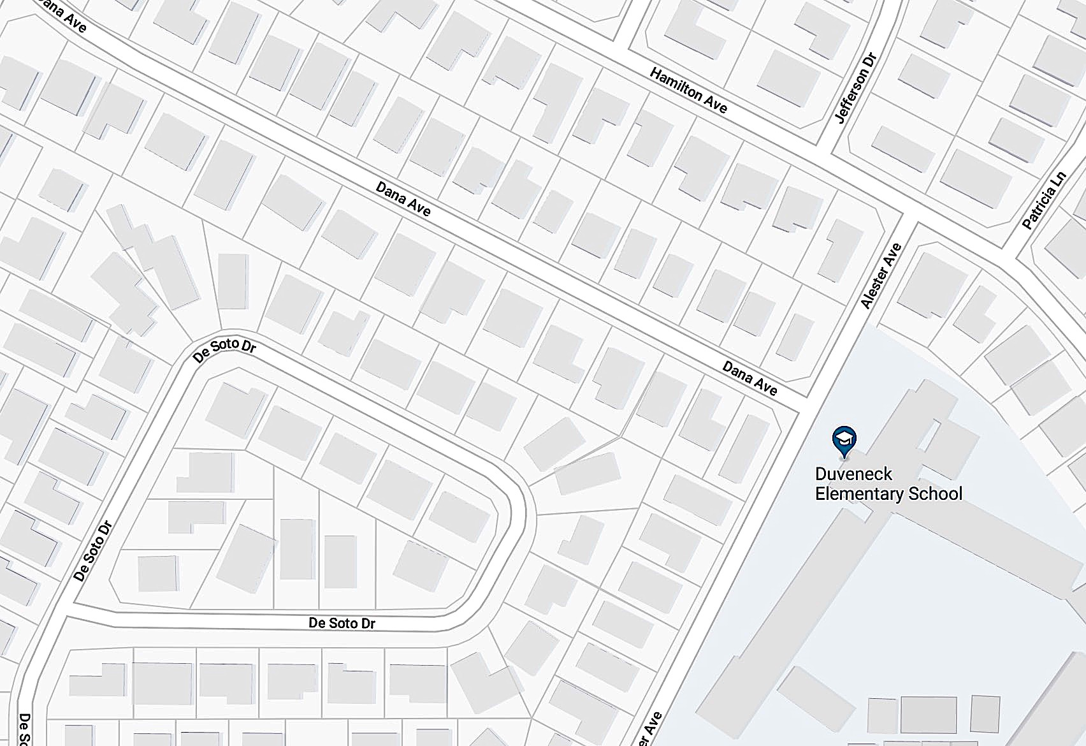
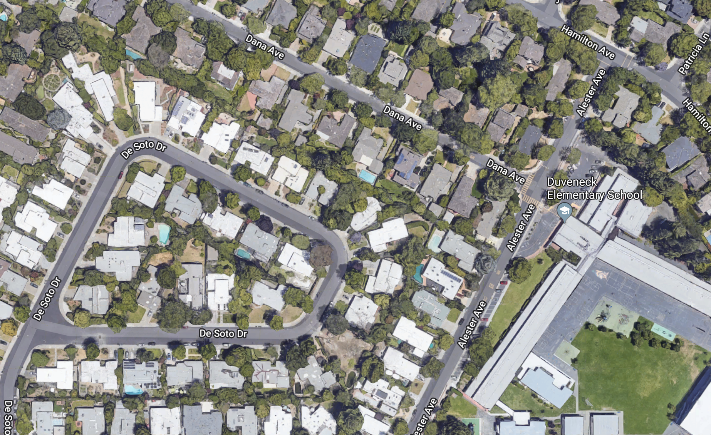
Data Collection
Labeling

Slide 7
Data Collection
Classification Directory Structure
ImageNet-Train/
Cat/
001.jpg
002.jpg
…
Dog/
…

Slide 8
Data Collection
Detection Directory Structure
Pascal VOC/
Images
001.jpg
002.jpg
…
Annotation
001.xml
…

Slide 9
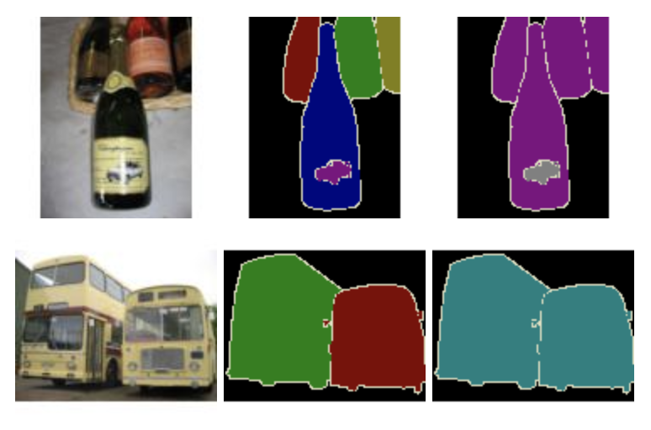
Data Collection
Segmentation Directory Structure
Pascal VOC/
Images
001.jpg
Object Segmentation
001.jpg
Class Segmentation
001.jpg

Slide 10
Data Loading with GluonCV

Slide 11
Data Loading with GluonCV
GluonCV Interface
DataSet
Input: images, labels
Output: Arrays of images and labels in memory
Transformation
Data augmentation
DataLoader
Scheduling
Multi-threading

Slide 12
Data Loading with GluonCV
DataSet
Task/Structure Dependent
Preset functions for certain structures
Very flexible
Class VisionDataset()
Users can override the class

Slide 13
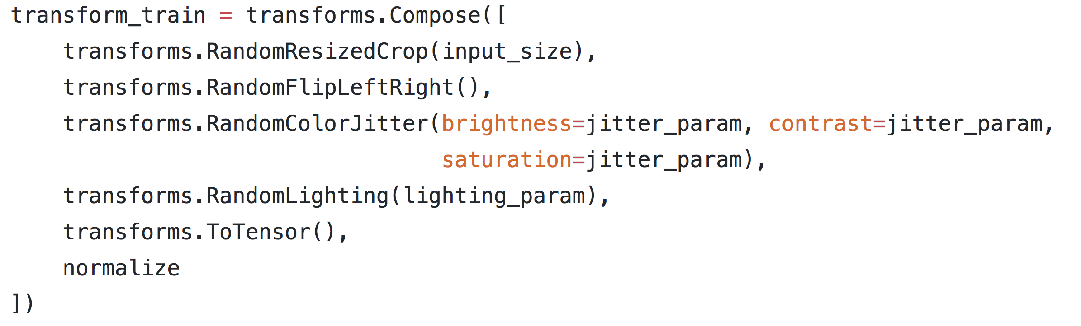
Data Loading with GluonCV
Transformation
Augmentation
Abundant choices
Flexible interface
Stack in sequence

Slide 14
Data Loading with GluonCV
DataLoader
Load Schedule
Pool of threads
Pre-fetch
Training/Testing specific
Data Shuffling
Batch size

Slide 15
Data Loading with GluonCV
GluonCV Interface
Pipeline
File -> Dataset -> Transformation -> DataLoader

Slide 16
Data Transformation with GluonCV

Slide 17
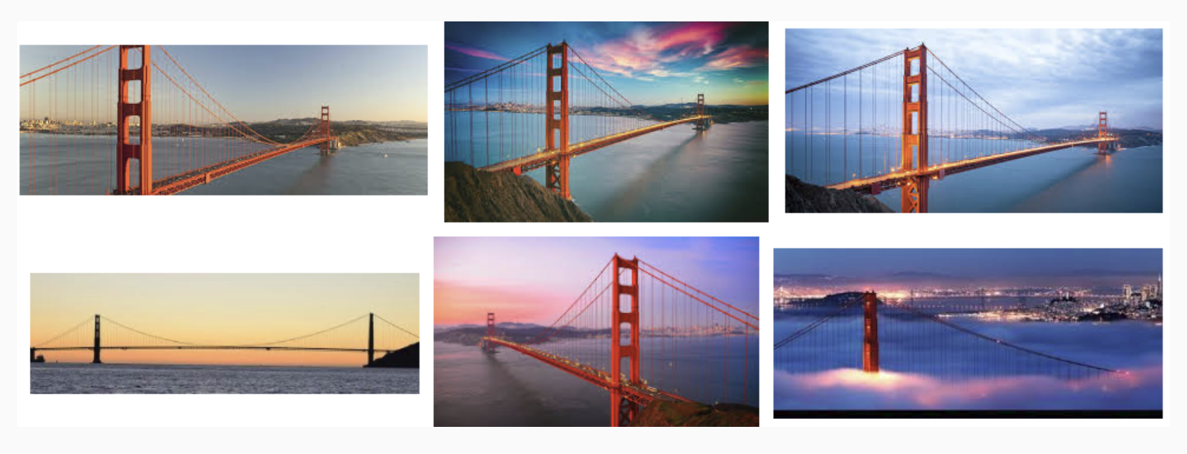
Data Transformation with GluonCV
Why Transformation?
Resize to fit model
Prevent overfitting
Enrich the dataset

Slide 18
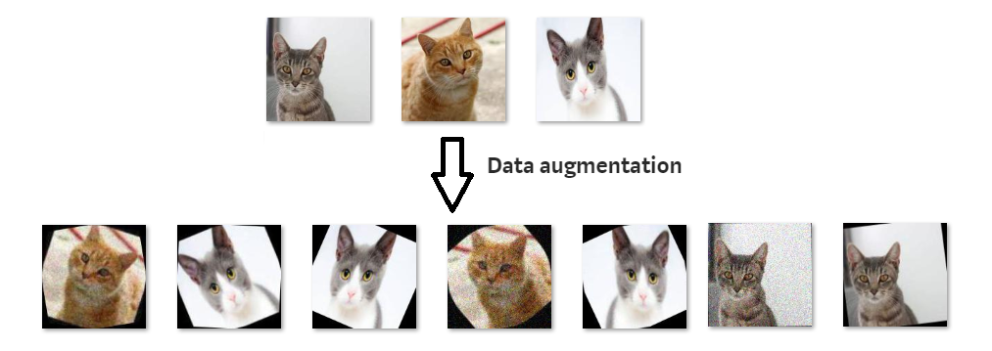
Data Transformation with GluonCV
Popular Transformation
Resize
Crop
Flip
Rotation
Adding Noise
Normalization

Slide 19
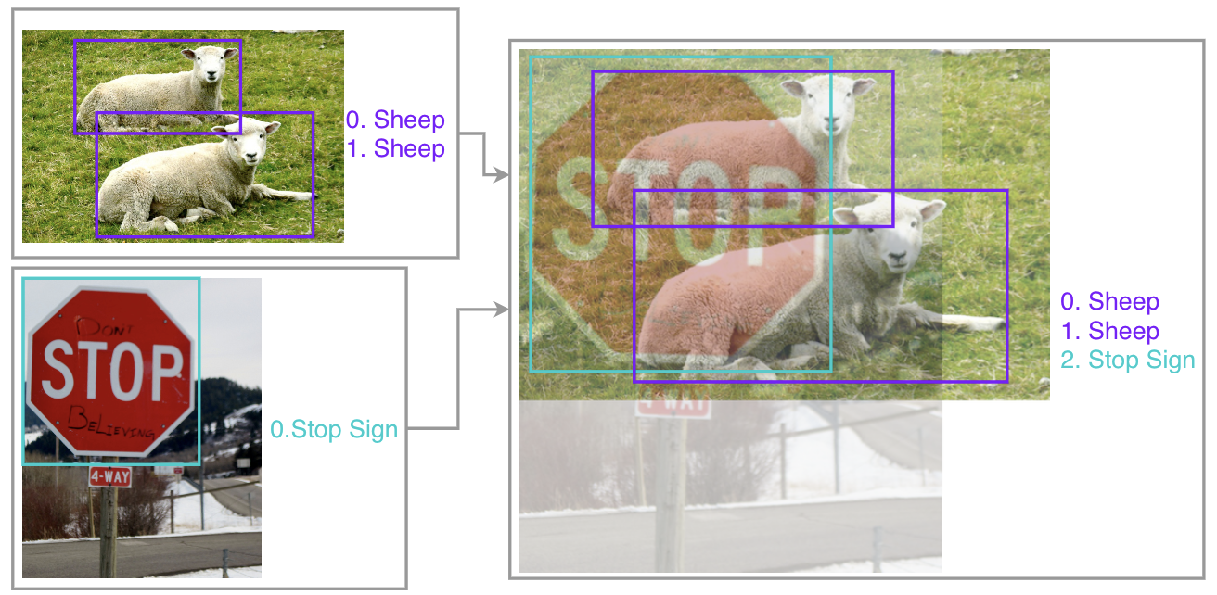
Data Transformation with GluonCV
Advanced Transformation
Mix-Up

Slide 20
Data Transformation with GluonCV
Transformation for Inference
Crop
Normalization
No Randomization

Slide 21
Fast IO in GluonCV

Slide 22
Fast IO in GluonCV
Hardware
RAM Disk > SSD >> HDD
ImageNet dataset: 140GB
RAM of p3.16xlarge: 768GB

Slide 23
Fast IO in GluonCV
Image Format: Raw Image
Support any kind of tasks
Read through DataLoader
Slow
Need to unzip on each new machine

Slide 24
Fast IO in GluonCV
Image Format: RecordIO
Support classification and detection
Read through DataLoader or ImageRecordIter
Fast
One-time packing

Slide 25
Fast IO in GluonCV
Interface: ImageRecordIter
One function call for
DataSet
Transform
DataLoader
Less flexible
Very Fast

Slide 26
Fast IO in GluonCV
Interface: Nvidia DALI (with nvJPEG)
Combination of
DataSet
Transform
DataLoader
Flexible
Extremely Fast
In-Development

